Slide 1

[Samsung PRISM] End Review Report
[Bixby, Capsules, Marketplace | Zomato capsule]
Team
College Professor: Asha G.R
Students:
Amogh Karhadkar
Akanksha Laddha
Vinay Kumar
B Praneeth
Department: CSE
Date: 06th April 2021

Slide 2

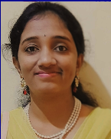

Work-let Area – Bixby, Capsules, Marketplace| Zomato capsule
Problem Statement
Bixby is powered by an open AI platform that enables developers to leverage existing APIs and services to build rich conversational experiences
Developers teach Bixby by building Capsules. Each Capsule contains everything Bixby AI needs to know starting from defining use cases and models to dialog and layouts
Create a capsule for Zomato using the open APIs provided by the provider
Bixby applies this knowledge to unseen words and sentences so it can consistently apply the correct meaning to user requests
Place the capsule in the Bixby Market place enables million of users to use tracker just with a button press
Work-let expected duration – 4 months
Expectations
Check the Open APIs supported by Zomato and create a capsule covering all features that can be derived from the open APIs
Bixby AI platform and Capsule understanding concepts like models, code, layouts and dialogs
Submit the capsule to Bixby Market place available for million of users
Training/ Pre-requisites
Understanding of Voice Assistant platform and NLU system
Good knowledge of Java Script language and JSON
Web services, HTTP methods like POST and PUT and OAuth
4
Students
Kick Off < 1st Month >
Understanding general Voice assistant concepts
Hands on with Bixby concepts and IDE with sample capsules
Understanding the Develop process from Bixby Developer portal
Test the open APIs to be used (if any)
Define goals, must work utterances and expected Bixby response for best user experience
Milestone 2 < 2nd Month >
Capsule – Zomato
Action and Concepts identification and definition along with vocab
Prepare the input, output mappers and end points
Create required JS files for the business logic, Bixby Views and NLGs
Variation creation for Training and add Vocabulary
E2E working for must work utterances
Milestone 3 < 3rd Month >
Account Linking
Identify the category and submit to market place
Closure < 4th Month >
E2E testing with natural utterances
Additional Documentation:
https://bixbydevelopers.com/dev/docs/get-started
https://bixbydevelopers.com/dev/docs/dev-guide
https://support.bixbydevelopers.com/hc/en-us/community/topics
https://bixby.developer.samsung.com/newsroom/en-us/
S Madhushree,
Senior Lead Engineer s.madhushree@samsung.com
+91- 8971775619
Janani Thangavel,
Chief Engineer
janani.t@samsung.com
+91- 9731822992

Slide 3
KPIs achieved
Hands on with Bixby concepts and IDE with sample capsules
Understanding the Develop process from Bixby Developer portal
Test the open APIs to be used (https://developers.zomato.com/)
Define goals, must work utterances and expected Bixby response for best user experience

Slide 4
KPIs achieved
Action and Concepts identification and definition along with vocab
Prepare the input, output mappers and end points
Create required JS files for the business logic and NLGs
Variation creation for Training and add Vocabulary
E2E working for must work utterances

Slide 5
Goals and must work utterances
Find restaurant details
Find details about Barbeque Nation
Find details of New Shanti Sagar
Find Timings
When will Barbeque Nation open?
When does Lavonne close
At what time does Annakuteera open?
Find timings for Vidyarthi Bahavan
Find Cost
What are the prices like at communiti
What is the average cost at Truffles
Find Restaurants
Find Italian Restaurants in Bangalore
Find restaurants near me
What are some good restaurants in Malleshwaram

Slide 6
Goals and must work utterances
Restaurant Reviews
Find reviews for Barbeque Nation
How good is New Shanti Sagar

Slide 7
Technical Challenges
1. Challenge faced in getting the geo location of the user
For utterances such as “Find restaurants near me", the user’s location plays a critical role, and the location data must be figured out by the Bixby itself.
How it was solved
After exploration we found that there's a library capsule provided by Bixby to access the user’s geo-location. We configured it and gave it the required permissions and solved the challenge
2. Working with Zomato API
Zomato stopped accepting new requests for using their API midway through the project. They removed their API documentation page as well.
How it was solved
Since we already had the API key, we were able to make requests and get the required information.
We had to find other websites for documentation.

Slide 8
Technical Challenges
3. Diversity of spoken languages and pronunciation
For the Zomato API to return correct results, correct spellings must be provided to it.
Ex: Banashankri – won’t work
Banashankari – will work
How it was solved
Again, the geo library was useful in this case.
Instead of directly providing the location name mentioned by the user, first that name is passed to the geo library, which searches for regions matching that search term and provides the correct spellings.
4. Cannot fetch a restaurant’s details by its name
There is no facility to find a restaurant by its name in the Zomato API.
How it was solved
When the user mentions a restaurant name, we can get it’s location (latitude and longitude) through geo library.
Then we can search for restaurants around that location and match the required restaurant among the list of restaurants found in that location.

Slide 9
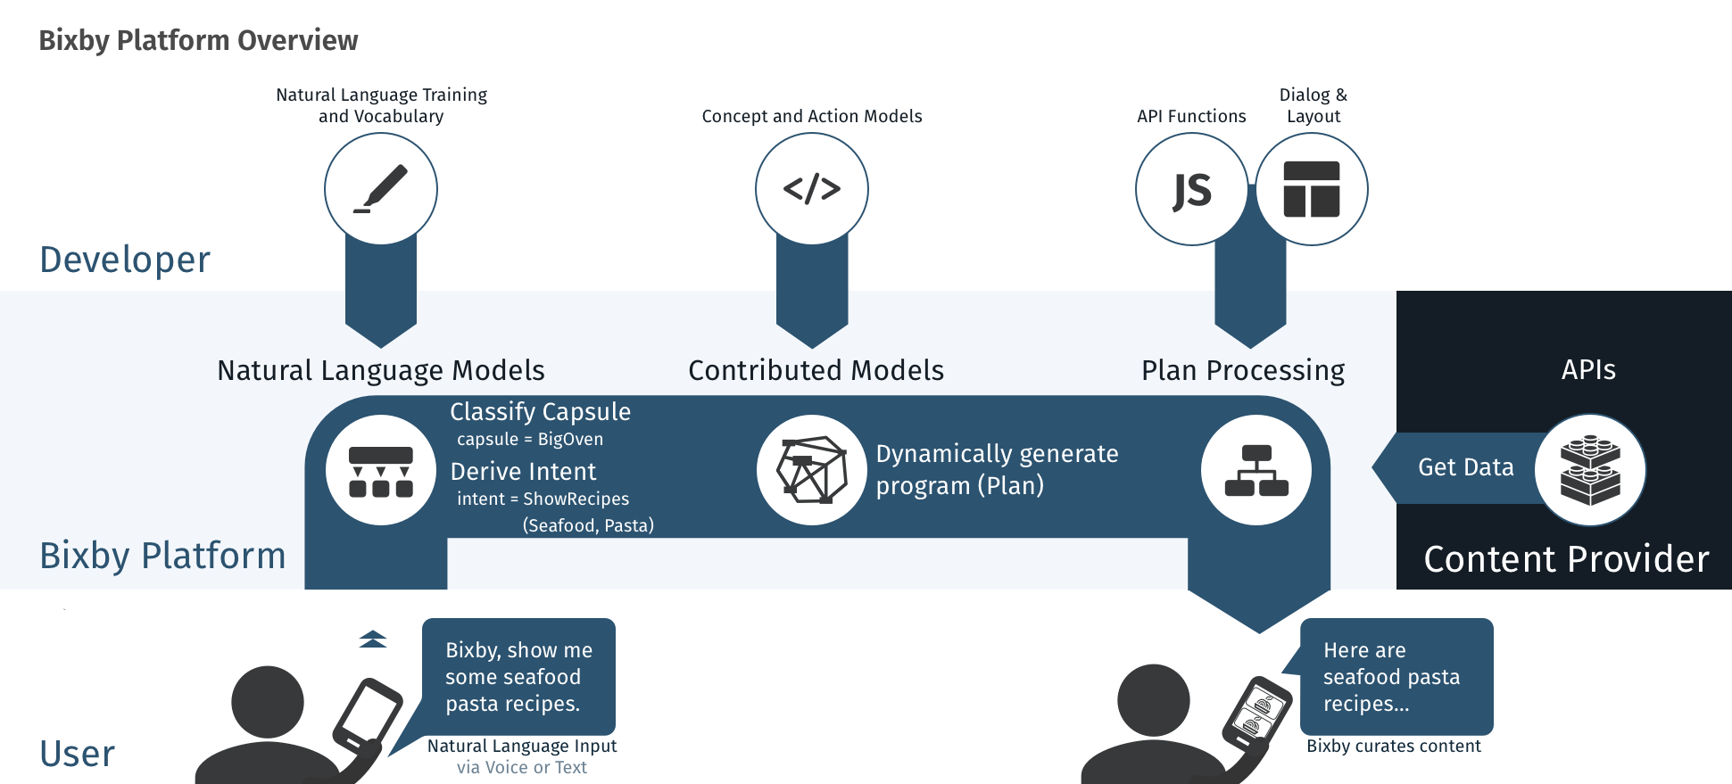
Proposed Approach / Solution
Concept Diagram :
( Clear detailed schematic / block diagram / flow chart depicting the proposed concept / solution )
Zomato
Capsule Zomato
FindRestaurants
(Chinese, Hebbal)
Find Chinese restaurants in Hebbal
Here are Chinese restaurants in Hebbal

Slide 10
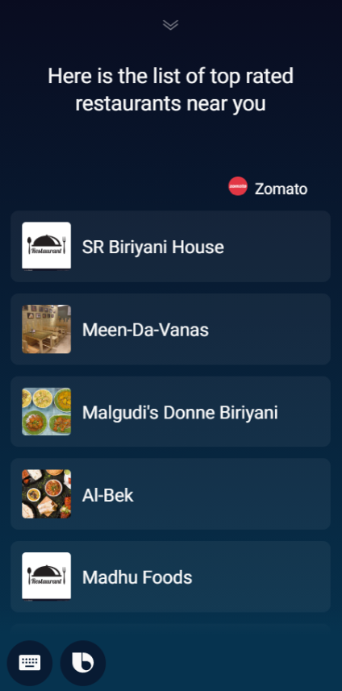
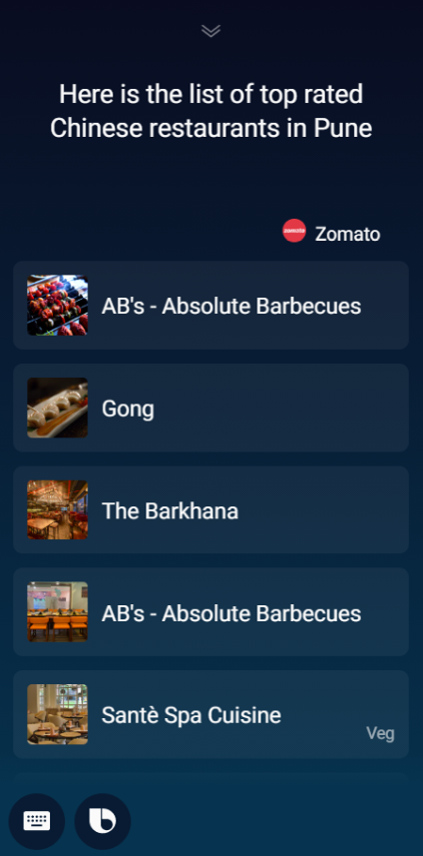
Simulations
Find restaurants
Find restaurants near me
Find Chinese restaurants in Pune

Slide 11
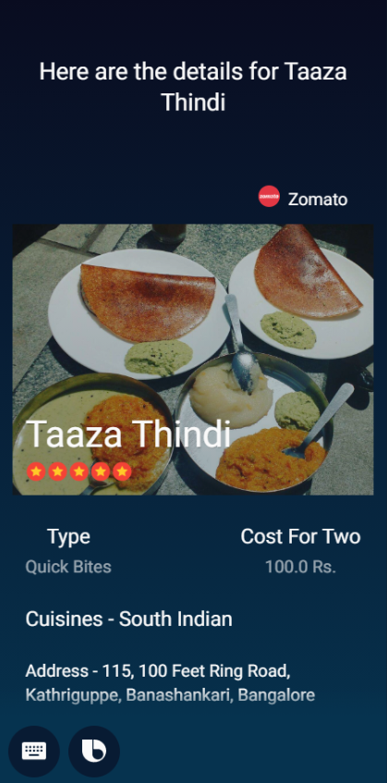
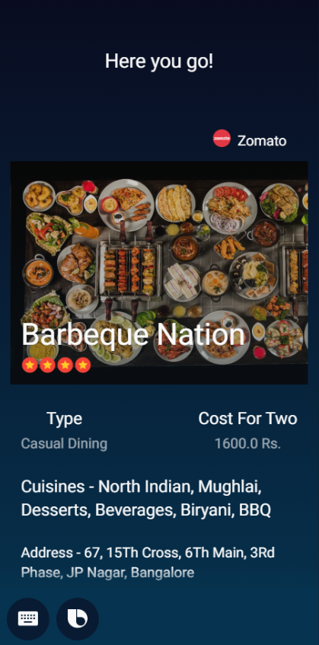
Simulations
2) Fetch restaurant details
Find details of Taaza Thindi
Find details about Barbeque Nation

Slide 12
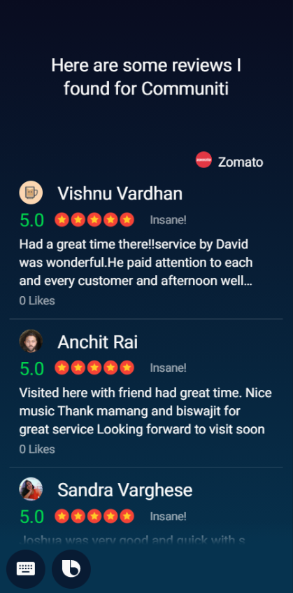
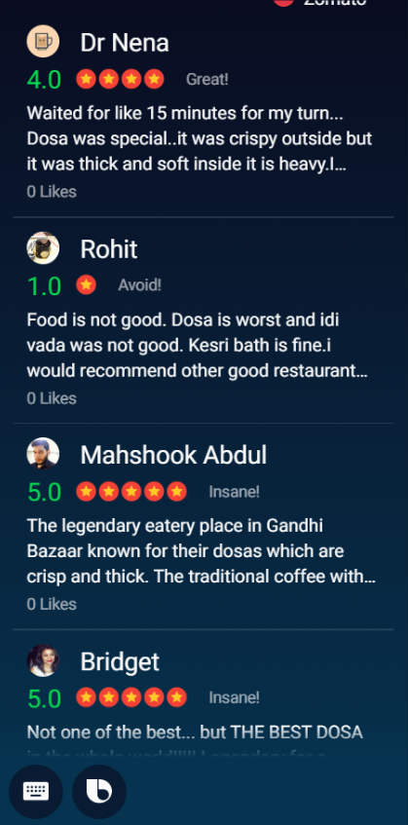
Simulations
3) Get reviews
How good is community
Find reviews for Vidyarthi Bhavan

Slide 13
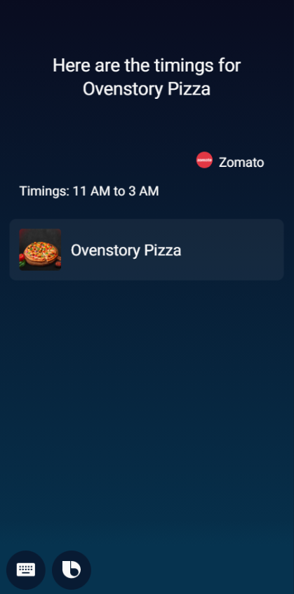
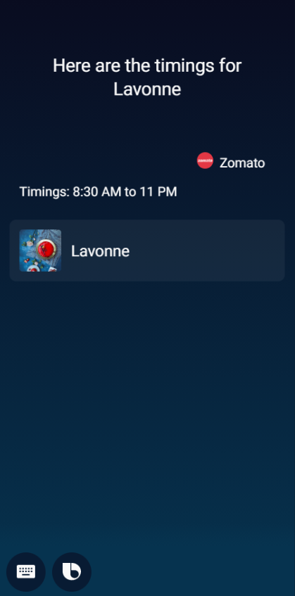
Simulations
4) Find Timings
What are the timings for Ovenstory Pizza
When does Lavonne close?

Slide 14
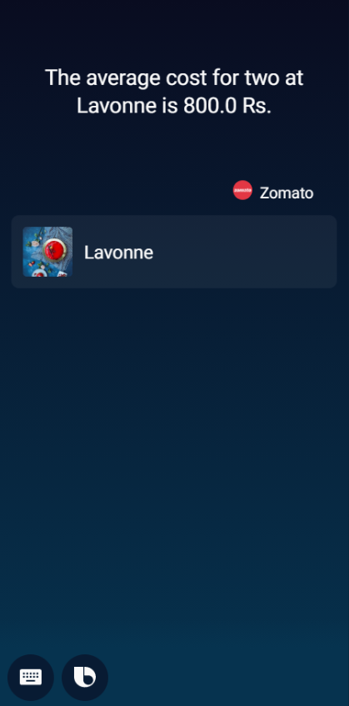
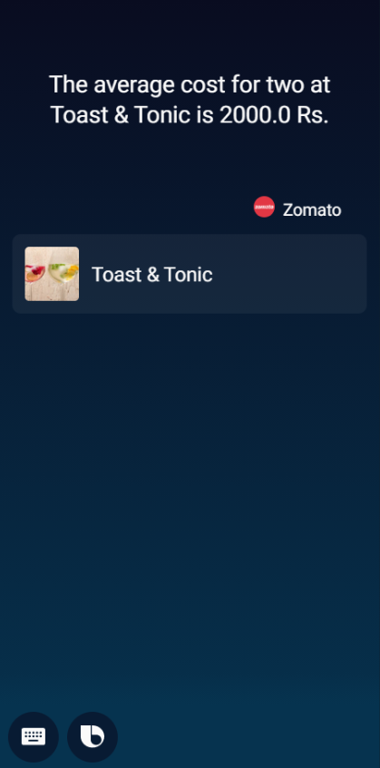
Simulations
5) Find Costs
What are the prices like at Lavonne?
What is the average cost at Toast and Tonic Richmond Road?

Slide 15
Major Observations, Learnings & Challenges :
Observations and conclusions
Bixby is the most underrated platform and has immense potential.
Bixby studio is easy to use.
Learnings
How to build a Bixby capsule (Actions, Concepts, Endpoints, Views, Dialogs)
How web APIs work
Providing NL training
Challenges
Diversity of spoken language and accent (Restaurant names, city names etc must be interpreted correctly by Bixby).
Limitations of Zomato API.

Slide 16
Work-let Closure Details
GitHub Upload details:
Parameter | Details
KLOC [Lines of Code in Thousands] | 1.4
Model /Algorithm Details | HTTP requests, JavaScript map, find and filter methods
Link to Github Repository | https://github.ecodesamsung.com/SRIB-PRISM/BMSCE_VI44BMS_Bixby_Capsules_Zomato_capsule

Slide 17
Thank you

